Slide 1
NE 763: Advanced Reactor Materials
Fall 2026
Dr. Benjamin Beeler

Slide 2
Last Time
F/M Steels
  excellent void swelling resistance: interstitial and vacancy behavior, as well as microstructure
  DBTT impacted by composition and by fabricated microstructure
  Swelling only reaches 1% at about 200 dpa
Radiation resistant austenitic steels
  Solves the high T creep strength issue of F/M steels, at the cost of swelling
  Try to push out incubation dose for swelling, after which ~1%/dpa swelling rate
  At high T, embrittlement will occur at ~6% swelling from cavities
  Cold work introduces dislocations, defect sinks, extending incubation dose
  Composition impacts swelling resistance, Ni often improving, Cr worsening, related to austenite stabilization
  Ti/TiC forms fine precipitates which act to stabilize dislocations and serve as defect sinks
  In a fast spectrum, Ni transmutation generating He becomes a problem

Slide 3
Fe-Cr-al steels

Slide 4
FeCrAl
FeCrAl alloys are expected to have excellent high temperature corrosion behavior and very low void swelling, making them viable candidates for both LWR and advanced reactors
Strong push over the last 15 years to develop FeCrAl after Fukushima, including it as an accident tolerant fuel concept
Alloying additions are weighed to target properties and microstructure
Al allows for formation of Al2O3, limiting high T steam corrosion
Too much Cr leads to sigma phase and alpha’ which cause embrittlement, while too much Al leads to the formation of Al intermetallics
Cr and Al act as bcc stabilizers such that FeCrAl is fully ferritic
Other alloying species are added to increase strength, modify precipitation, etc.

Slide 5
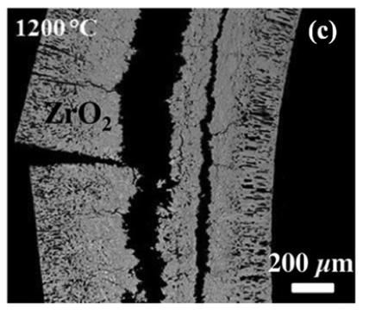
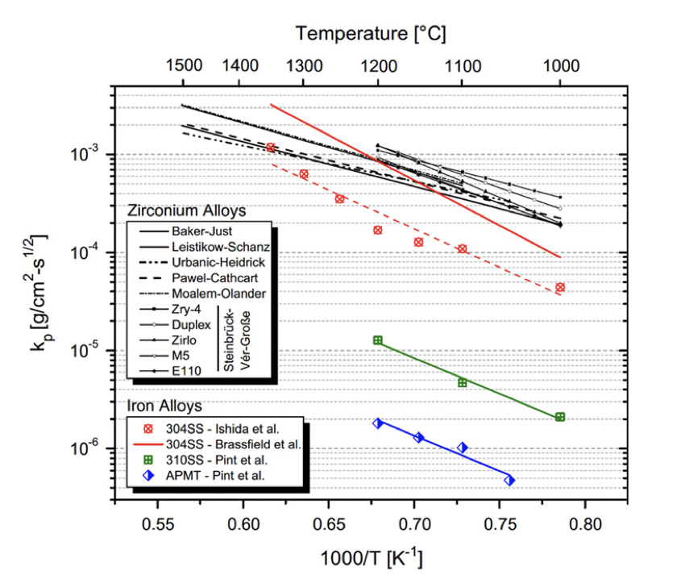
Oxidation Resistance
For applications in LWRs or other water-cooled systems, current cladding (zircaloy) exhibits excessive oxidation at T > 1200 C
FeCrAl can form a stable Al2O3 layer on the surface that is relatively resistant to high temperature steam corrosion
Comparing rate constants of zircaloy, SS, and FeCrAl (APMT), significant oxidation resistance is gained for FeCrAl
An Al2O3layer is significantly more stable under high T steam than either Cr2O3 or ZrO2; slower growth rate of Al2O3

Slide 6
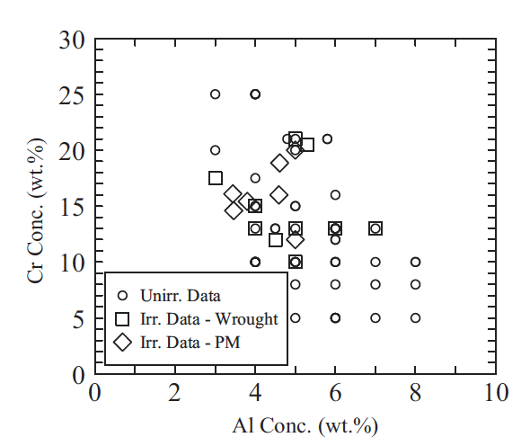
Compositional Limits
A range of alloys have been studied for radiation tolerance utilizing different fabrication techniques
Typically operate from 5-25 wt.%Cr and 2-8wt%Al
If too little Cr/Al is present, get poor high temperature corrosion resistance
Too much Cr/Al, embrittlement and fabrication issues
Too much of either Cr or Al, unfavorable precipitation behavior
Kanthal APMT (common reference FeCrAl) is 21Cr-5Al-3Mo (<1% SiMnC)
Unirradiated and irradiated compositions studied for FeCrAl alloys for both ingot metallurgy derived and powder metallurgy samples

Slide 7
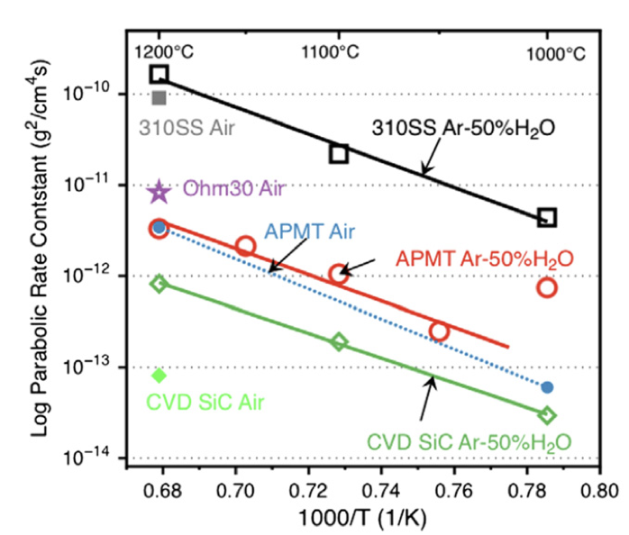
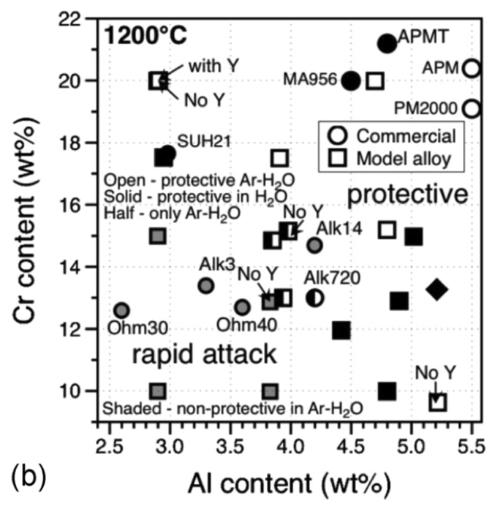
Oxidation Resistance
The composition of the FeCrAl alloy determines its ability to form passivating layers at high T
At a chromium content of 10 wt%, alloys investigated with Al content < 4.5 wt% did not form protective oxide scales
With increasing Cr and Al content, e.g., 12wt% Cr and 4.5 wt% Al, protective scales formed
At ~18 wt% Cr and as low as 3 wt% Al content, a protective oxide can still be formed
This oxidation behavior, in conjunction with irradiation behavior (coming next), determines viable composition ranges of FeCrAl

Slide 8
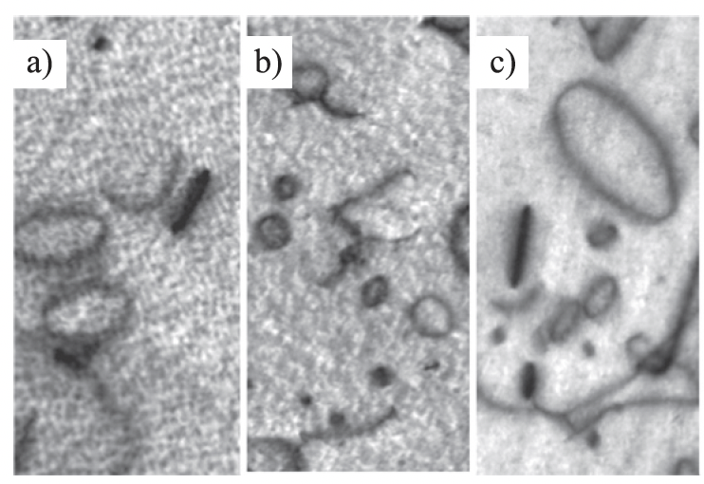
Irradiation Behavior
Effectively no void swelling has been observed up to 23 dpa and 600C
These alloys are expected to display excellent void swelling resistance characteristic of ferritic alloys
Both vacancy and interstitial loops of specific orientations are known to form, regardless of minor compositional variances
Loop size and density are impacted by composition and as-fabricated microstructure

Slide 9
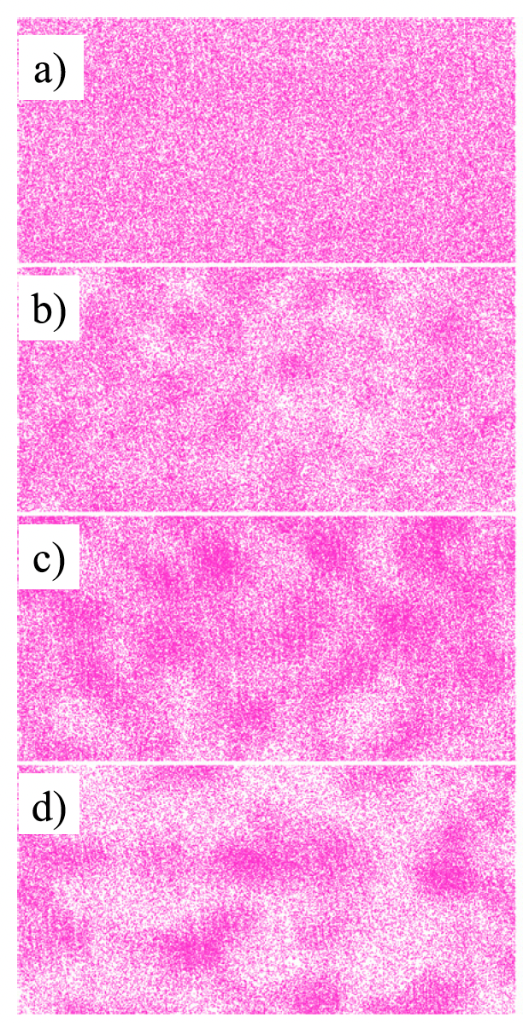
alpha’ Precipitation
Like other high-Cr ferritic alloys, FeCrAl alloys have been shown to be susceptible to irradiation-enhanced precipitation of the Cr-rich alpha’ phase
Embrittlement due to alpha’ formation has a high likelihood of being the primary factor dictating the useful lifetime of FeCrAl components
Aluminum is believed to inhibit, but not prevent, alpha’ precipitation
Irradiation enhanced diffusion accelerates the Cr precipitation, reducing the temperature and Cr-content at which alpha’ is expected to form
Atom probe tomography Cr atom maps during neutron irradiation

Slide 10
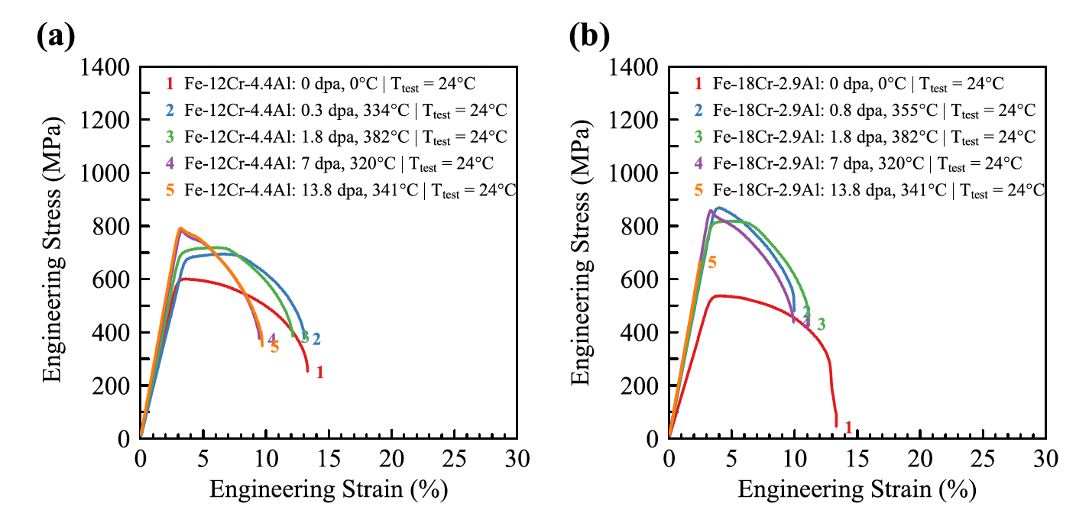
Irradiation Hardening
FeCrAl shows pronounced increases in yield strength and corresponding decreases in total elongation due to dislocations and alpha’ precipitates
The general trend is an initial regime where the yield strength steeply increases with increasing dose and then reaches a saturation
Saturation in ductility is typically around 10% elongation
Some high-Cr alloys have shown a third stage of complete embrittlement

Slide 11
Integral Experiments: Recent Results
Driven mainly by GE Vernova/GNF (IronClad) with ORNL and INL; Japan (Hitachi-GE, NFD, JAEA) is pursuing FeCrAl-ODS
ATR water loop (ATF-2): fueled C26M rodlets to ~25 GWd/tHM
  C26M is Fe-12Cr-6Al-2Mo developed by ORNL/GE
  Micro-cracking at the metal-oxide interface
Hatch BWR: unfueled C26M lead test rods
  Dislocation loops and Cr-rich clusters at ~280C; brittle at room T, up to 3% uniform elongation at operating T
Clinton BWR: first fueled FeCrAl rods in a commercial reactor; no PIE found in the open literature
Fueled FeCrAl-ODS rodlets planned for ATR (JAEA/Hitachi-GE)
Still no high-burnup or irradiated-transient data; GE treats FeCrAl as a mid-term concept

Slide 12
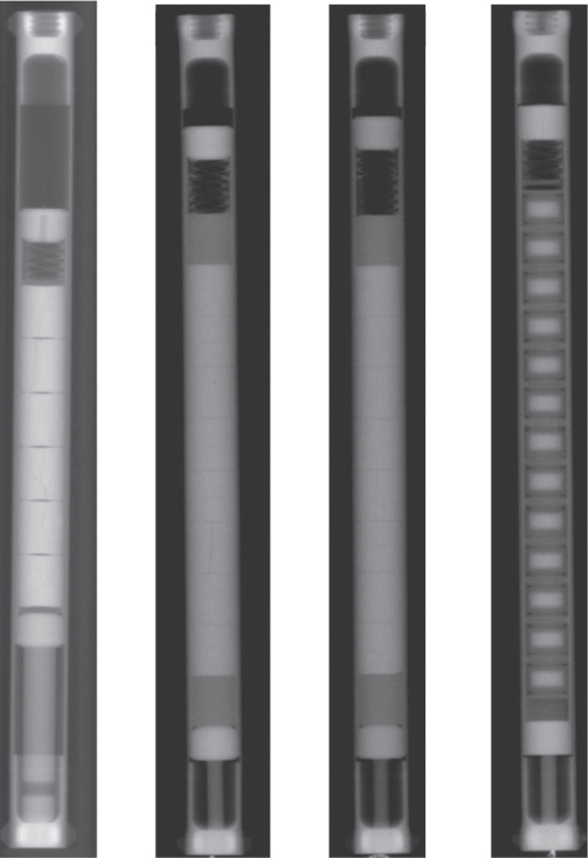
Integral Experiments
FeCrAl is still relatively poorly explored in integral expts
Only a handful of irradiation+corrosion tests; only a handful of fueled cladding tube tests
No “major” issues identified, but nothing extended to high burnup or transients
So, it is a promising material, but still a long way to go to verify its suitability

Slide 13
FeCrAl Summary
Ferritic steel
  Excellent void swelling resistance
  Lower strength, especially creep strength above 600 C
Main goal is to form Al2O3 oxide layer, which is more stable than Cr2O3 under high temperature steam
Compositional ranges stabilize ferrite, provide corrosion resistance, allow for some precipitation+strengthening
Susceptible to high T alpha’ precipitation (Cr-rich) which can embrittle

Slide 14
ODS Steels

Slide 15
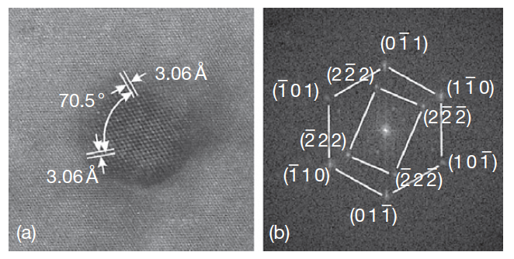
Oxide Dispersion Strengthened Steels
Thermally stable oxide particles dispersed in the ferritic matrix improve the radiation resistance and creep resistance at high temperature – high sink/barrier density
ODS steels have a strong potential for high burnup and high temperature applications typical for advanced reactors
Allow the system to retain essentially a fixed microstructure with irradiation
Typically, Y2O3 particles or Y2Ti2O7 particles
HRTEM of Y2O3 particle with surrounding matrix

Slide 16
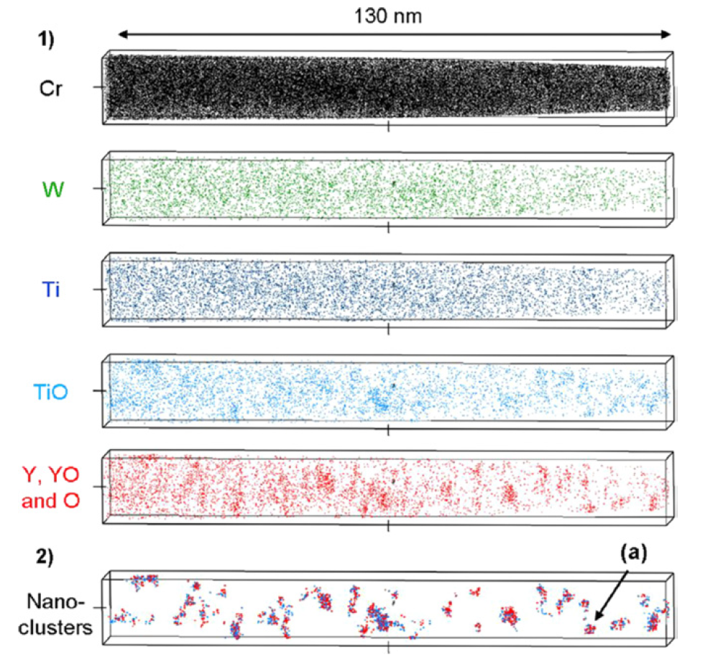
Y2O3 Decomposition
The fine distribution of Y2O3 particles is attained by the dissociation of stable Y2O3 particles which are forced to decompose into the ferritic steel matrix during the mechanical alloying (MA) process
MA: metal and oxide powders are milled together in a high-energy ball mill until they are mixed at the atomic scale
The lattice structure change of Y2O3 in the ODS steel during MA consists of three stages: (1) destruction of the lattice structure, (2) formation of a blurry lattice structure, (3) appearance of amorphous areas
Particles precipitate under heat treatment

Slide 17
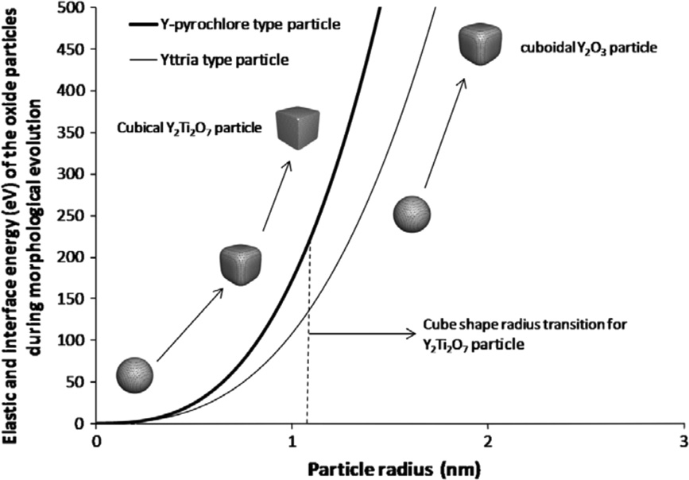
Oxide Particle Structure
The structure of the nanoparticles depend on sintering/pressing temperature and time, excess oxygen concentration, etc.
Particles usually evolve from spheroids to cuboids with time/size
Interfacial energy increases with particle size
Misfit strain typically increases with particle size
Y2O3 particles will be larger than Y2Ti2O7 particles

Slide 18
9Cr-ODS
For nuclear applications, the choice of 9 wt% Cr with a tempered martensitic matrix is preferable to suppress the ductility loss by irradiation hardening and improve the microstructure stability and creep strength at high temperature
The high-temperature strength of 9Cr is drastically improved by nano-scale oxide particles dispersed in the matrix
The standard chemical composition of 9Cr-ODS being developed by the JAEA for SFR application is 9Cr–0.13C–0.2Ti–2W– 0.35Y2O3 (wt%)
The addition of titanium produces the nanoscale dispersion of oxide particles
Tungsten of 2 wt% is also added to improve high-temperature strength via solid solution hardening

Slide 19
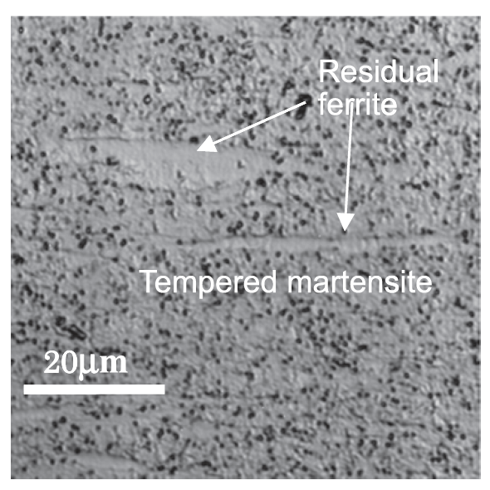
9Cr-ODS microstructure
The microstructure of 9Cr-ODS steel cladding is basically tempered martensite, but includes some residual ferrite phases
Only the full martensite phase can be expected in 9Cr-ferritic steel without yttria under the same conditions
The high temperature strength is greatly improved with the ferrite, and thus control of ferrite is key in ODS fabrication
This is not ordinary soft ferrite; oxide particles pin the interfaces, making this phase very hard

Slide 20
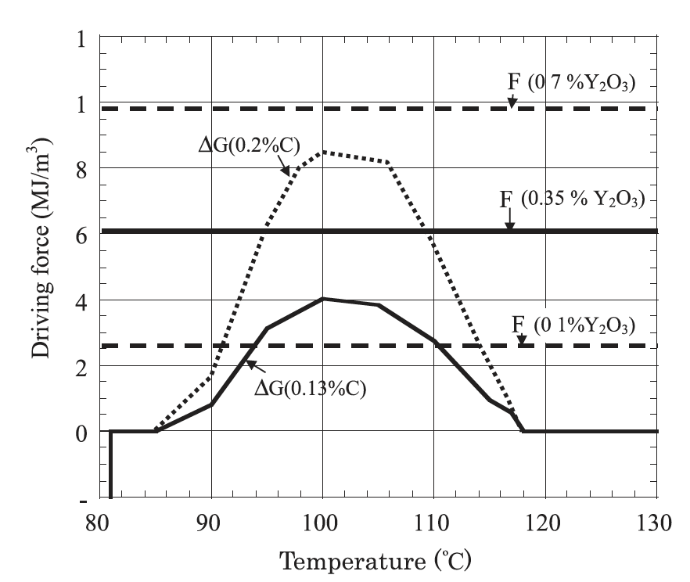
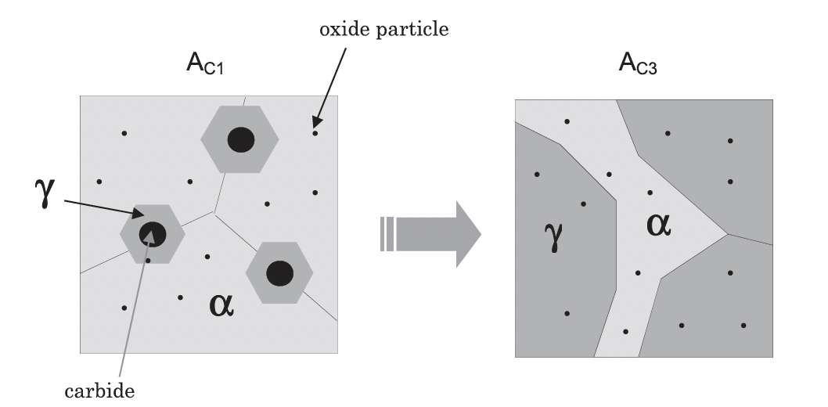
Residual Ferrite
Annealing results in the formation and precipitation of Y–Ti complex oxide particles
This heat treatment should convert ferrite into austenite, but when Y2O3 is present, we retain ferrite at high temperature and through quenching
These oxide particles block the motion of the alpha-gamma interface, there by partly suppressing the reverse transformation from alpha to gamma-phase

Slide 21
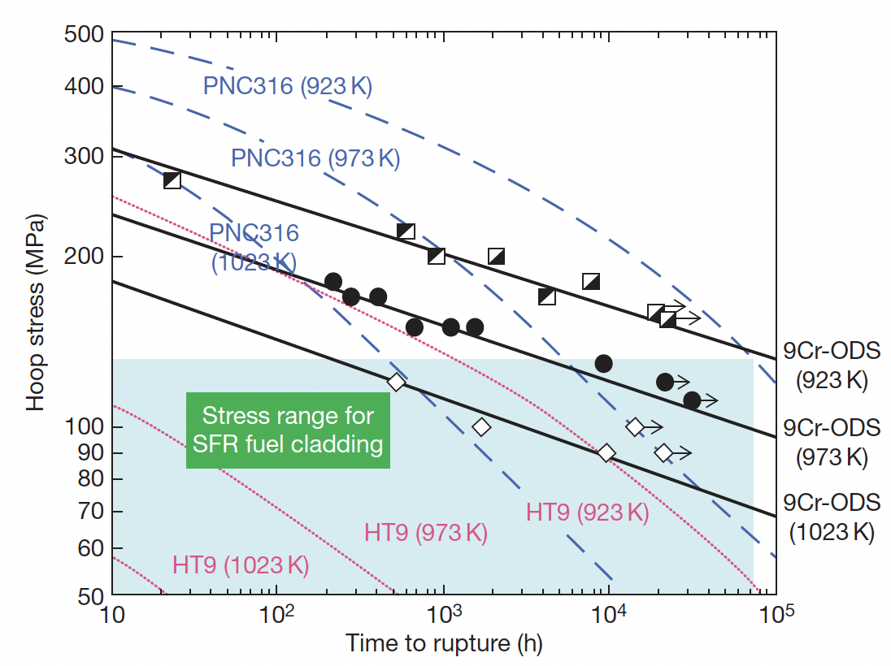
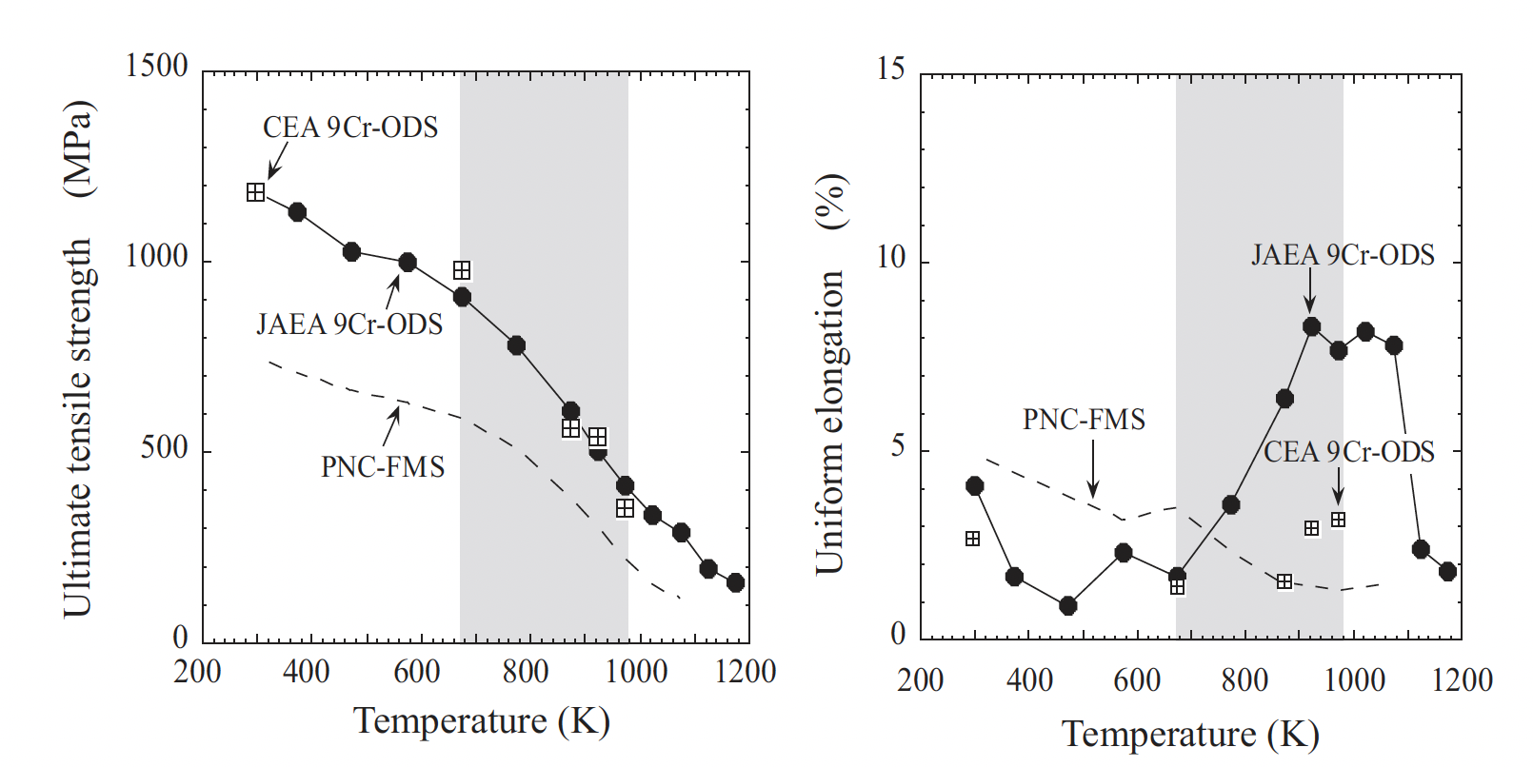
Mechanical Properties
The lifetime of a SFR cladding is mostly determined by the internal creep rupture strength with the internal pressure of the fission gas at a temperature of ~700C
PNC316 is an austenitic steel used developed by JAEA for fast reactors
PNC-FMS is a F/M steel
9Cr-ODS steels have superior creep resistance and higher tensile strength

Slide 22
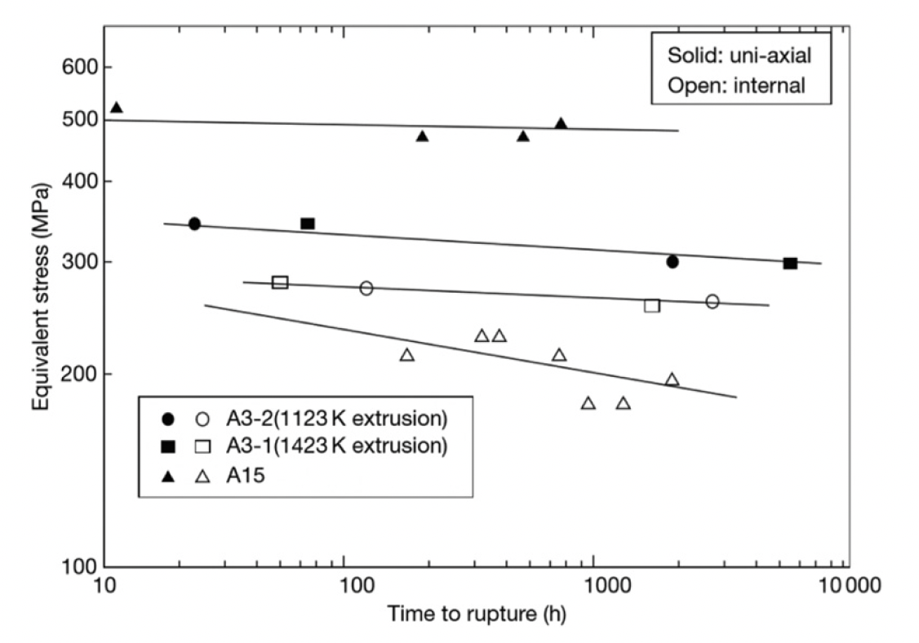
Ferritic 12Cr-ODS Steel
Development of ODS steels began with purely ferritic types, similar to MA957
While these types of steel exhibit excellent creep rupture resistance, there is anisotropy of the rupture strength
Can form elongated grains due to fabrication, weakening cladding in hoop direction
If the Y2O3 content is kept sufficiently low, an equiaxed grain structure can be maintained, providing more isotropic mechanical properties
Creep rupture strength of recrystallized (A3) and unrecrystallized (A15) 12Cr-ODS steels at 650C

Slide 23
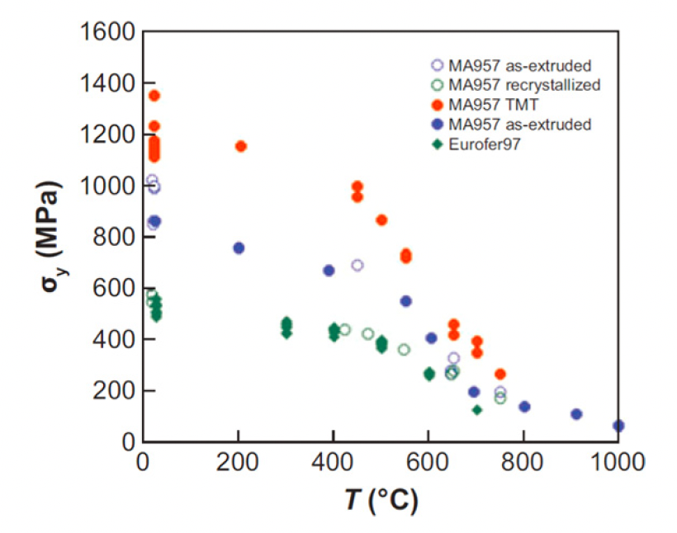
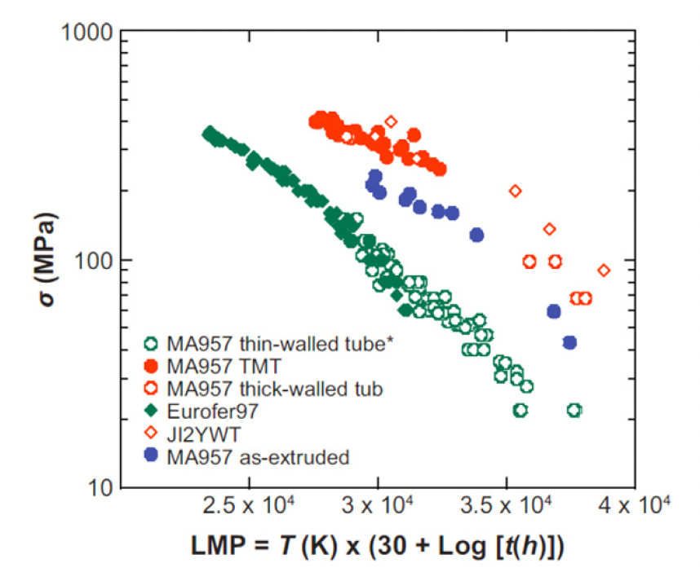
NFAs
Nanostructured ferritic alloys (NFAs) are 12%–20% Cr ferritic stainless steels that are dispersion strengthened by a very high density of ultrafine Y-Ti-O nanofeatures
Roughly same quantity of Y2O3 added, but particles much smaller (2-4 nm compared to 10-30 nm)
This high density creates fine grain and dislocation structures
This can yield excellent strength and radiation resistance, but makes fabrication processes very difficult
MA957 is an NFA, Eurofer97 is an F/M steel

Slide 24
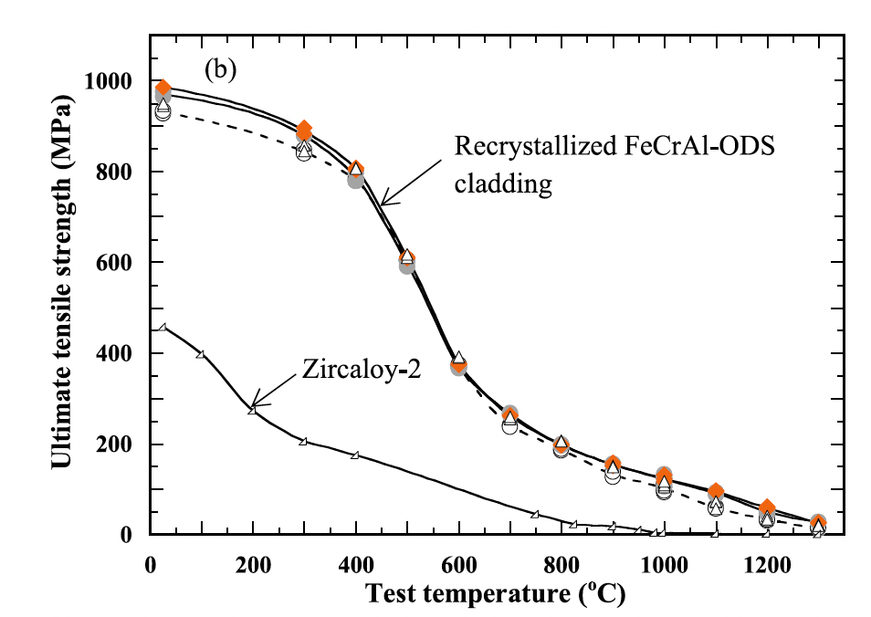
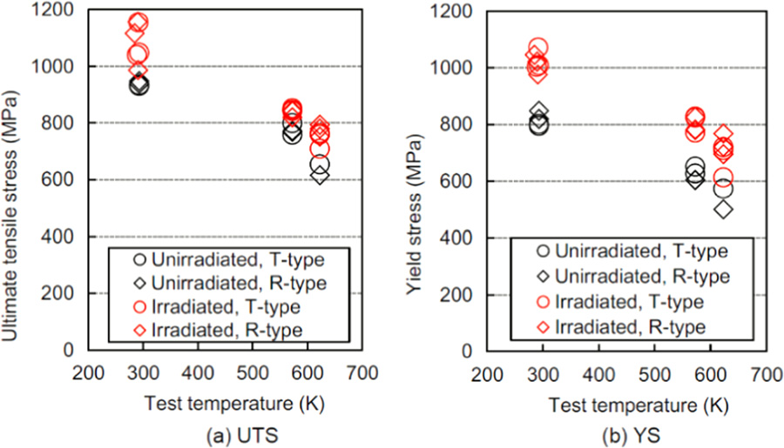
FeCrAl-ODS Steel
FeCrAl steels, with and without ODS are of interest
A nominal composition of Fe-10Cr-6.1Al-0.3Zr (wt%) with 0.3wt% Y2O3 has been studied by ORNL, a number of different alloys explored by JAEA program
Zr is added to prevent ‘large’ Y-Al oxide particle formation
The creep rupture strength of Zr-added FeCrAl-ODS cladding is beyond the existing 9CrODS and 12CrODS steel claddings for fast reactors
T-type (transverse direction) and R-type (rolling direction)

Slide 25
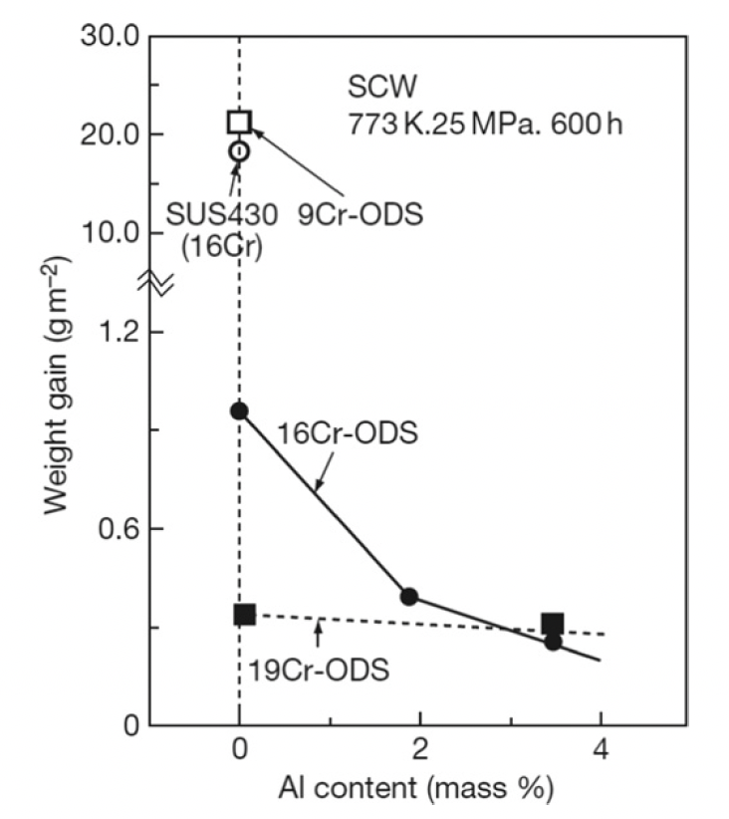
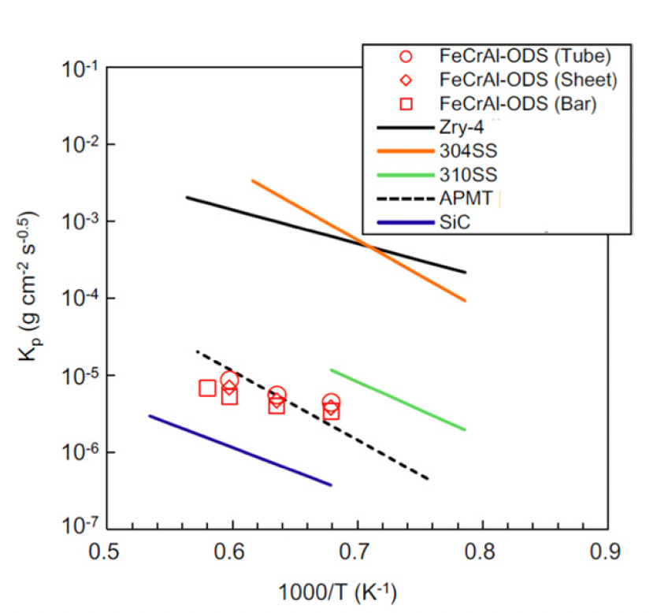
Corrosion
Hot steam oxidation tests are fairly limited in ODS steels
Additional Cr improves corrosion resistance, and Al content greater than 2 wt% provides a protective barrier
Excess oxygen content in the alloys can serve to suppress corrosion
In systems with high amounts of excess oxygen, Zr content can further aid in corrosion resistance

Slide 26
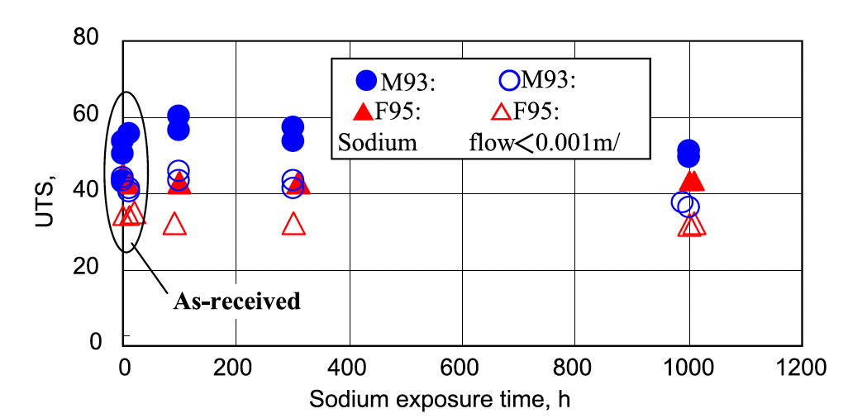
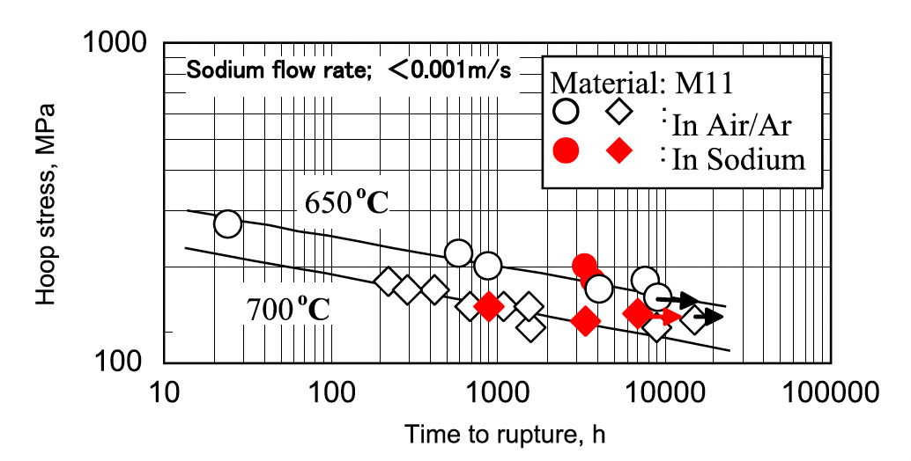
Liquid Na Compatibility
OSD-steels display excellent compatibility with liquid sodium
Both 9Cr and 12Cr ODS steels show no degradation in UTS after prolonged exposure to Na
Creep rupture behavior of ODS steels in air is identical to that in liquid Na
Under irradiation, this corrosion behavior may change, but has not been thoroughly studied

Slide 27
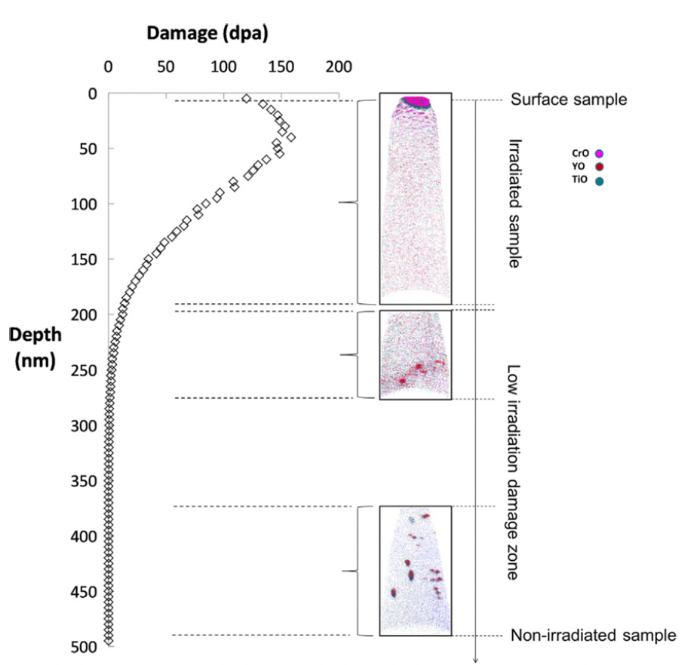
Irradiation Effects
The stability of the oxide particles under irradiation is the key factor in these alloys maintaining their advantageous mechanical properties under operation
Ballistic dissolution-the ejection of atoms from oxide particles due to high energy PKAs and the disordering of the particles-changes the nature of particles under irradiation
Complete dissolution of particles has been observed via APT

Slide 28
Irradiation Effects
At higher temperatures where vacancy diffusion is possible, ballistic dissolution works in conjunction with irradiation-assisted diffusion and changes the oxide particles
The atoms ejected from oxide particles can diffuse back to the original oxide particles, stay in the matrix, or reach other oxide particles
Most studies have reported that the size and number density of the oxide particles hardly change compared to how they were before irradiation
The predominant mechanism of of recovery is the back diffusion to the original oxide particles or re-joining to other existing oxide particles

Slide 29
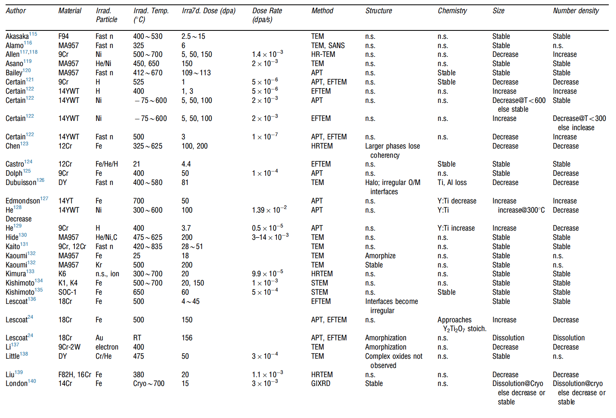
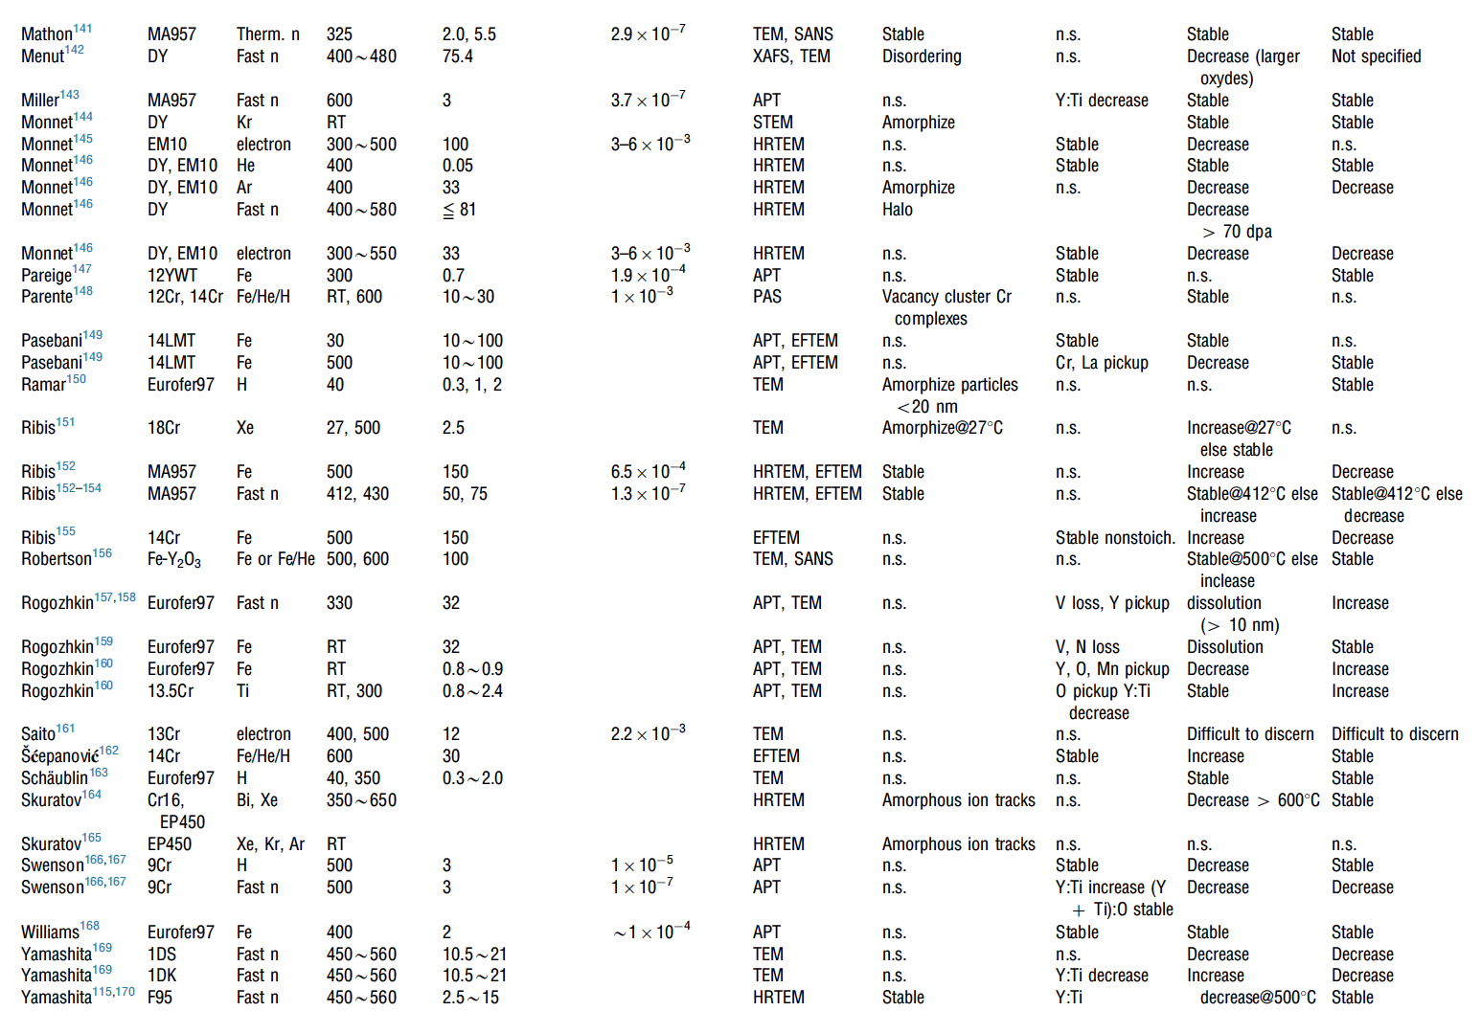
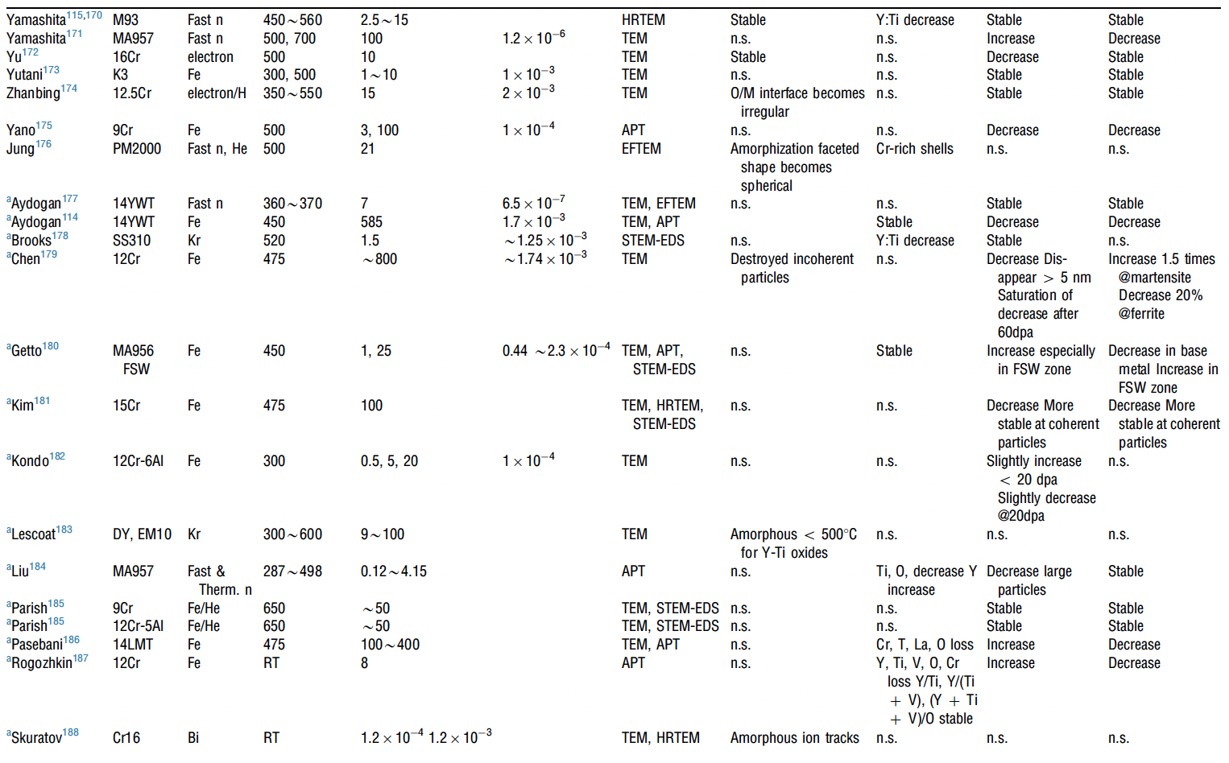
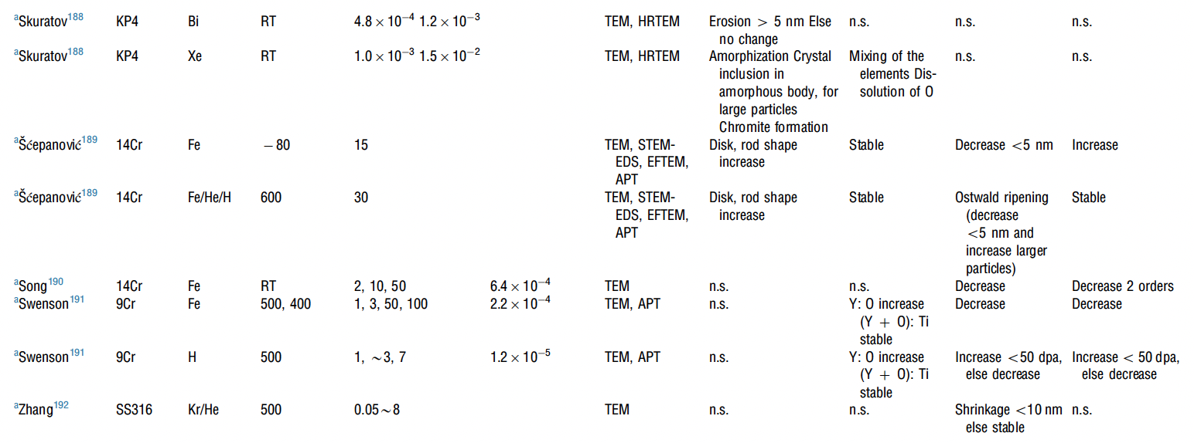
Irradiation Effects
A large number of irradiation experiments have been performed and analyzed to study the evolution of oxide particles
It appears that there is no correlation between irradiation dose, irradiation temperature, and the trend of change in size or number density of oxide particles

Slide 30
Irradiation Effects
Swelling:
  ODS steels are very swelling resistant, as the oxide particles trap vacancies and gas atoms, resulting in very small and homogeneously dispersed voids/bubbles
Hardening:
  hardness increases due to irradiation in ODS steels are smaller than in non-ODS steels
  Oxide particles dominate hardness, and act as sinks for generated point defects

Slide 31
Fabrication Challenges
Mechanical alloying is a slow batch process (tens of hours of milling), limiting scale and driving cost
  Milling picks up O, C, and N and wear debris; excess oxygen must be tightly controlled
Hot extrusion elongates grains along the tube axis, giving anisotropic strength with the hoop direction weakest
ODS steels are hard with low room-temperature ductility, so thin-walled tubes need many cold-rolling passes with intermediate softening anneals to avoid cracking
  9Cr grades soften and reset the grain structure through the alpha-gamma transformation; fully ferritic grades must be recrystallized, which is difficult to control
Fusion welding melts the matrix and the oxide particles agglomerate, so the weld loses its strengthening
  End caps are joined by solid-state methods, e.g., pressure resistance welding or friction stir welding
Alternative routes (cold spray, additive manufacturing) are being explored but are immature
Sources: Toualbi et al., J. Nucl. Mater. (2012); Maier et al., Nucl. Eng. Technol. (2019); review of ODS steel manufacturing, Processes 13 (2025) 1572.

Slide 32
Summary
ODS is fabricated through mechanical alloying and subsequent annealing
9Cr-ODS steel has a unique structure consisting of tempered martensite and residual ferrite that induces superior strength through finely dispersed oxide particles
NFAs have a very high density of oxide particles, producing very high strength and creep resistance, at the cost of workability
FeCrAl-ODS can provide superior corrosion resistance while retaining the ODS influenced mechanical properties
Further in-reactor studies on ODS steels need to be performed
While performance of ODS steels is widely studied, current production is limited to laboratory scale, with prohibitive costs for large scale production

